Slide 1

Inverse Trigonometric Functions: Integration
5.8
Copyright © Cengage Learning. All rights reserved.

Slide 2
Objectives
Integrate functions whose antiderivatives involve inverse trigonometric functions.
Use the method of completing the square to integrate a function.
Review the basic integration rules involving elementary functions.

Slide 3
Integrals Involving Inverse Trigonometric Functions

Slide 4
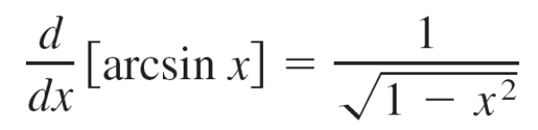
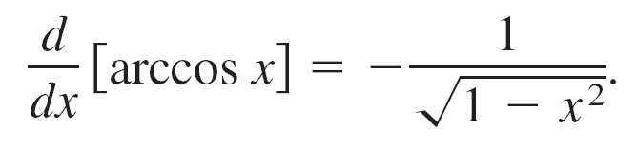
Integrals Involving Inverse Trigonometric Functions
The derivatives of the six inverse trigonometric functions fall into three pairs. In each pair, the derivative of one function is the negative of the other.
For example,
and

Slide 5

Integrals Involving Inverse Trigonometric Functions
When listing the antiderivative that corresponds to each of the inverse trigonometric functions, you need to use only one member from each pair.
It is conventional to use arcsin x as the antiderivative of rather than –arccos x.

Slide 6
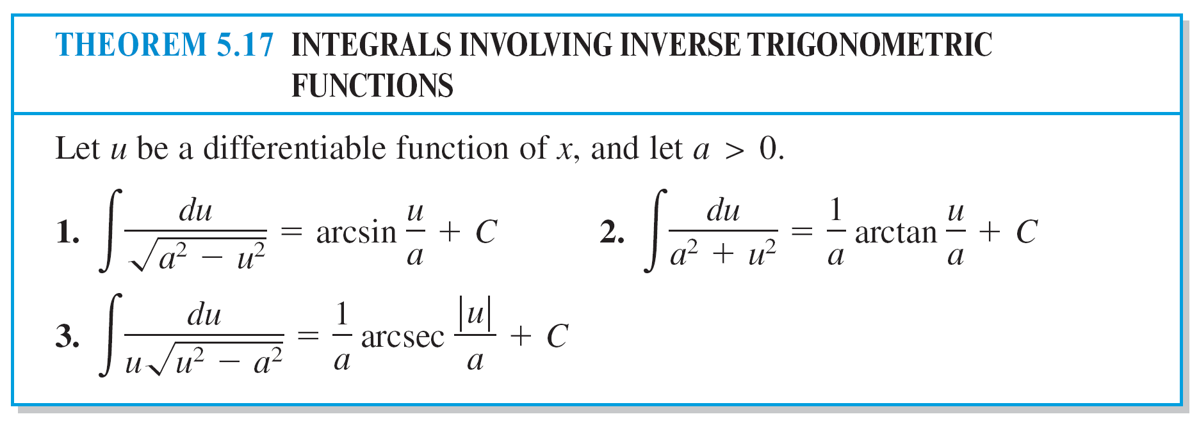
Integrals Involving Inverse Trigonometric Functions

Slide 7
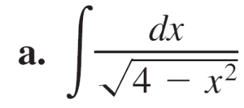
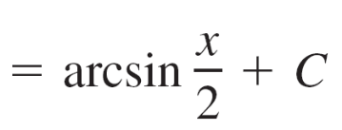
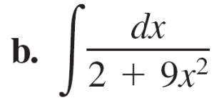
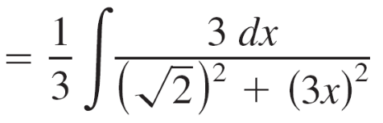

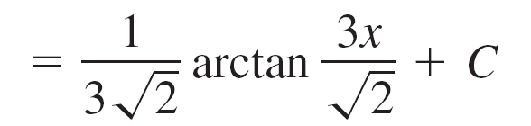
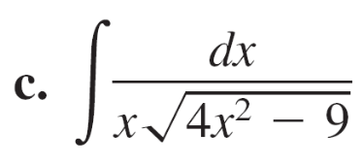
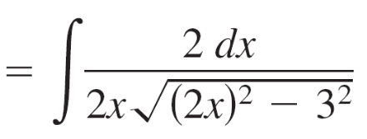

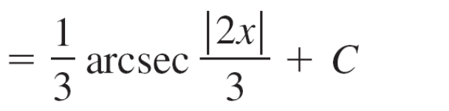
Example 1 – Integration with Inverse Trigonometric Functions

Slide 8
Completing the Square

Slide 9
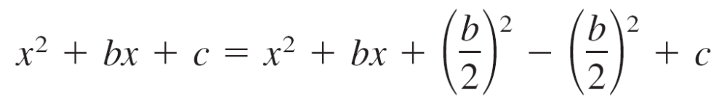
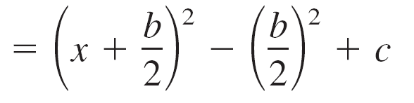
Completing the Square
Completing the square helps when quadratic functions are
involved in the integrand.
For example, the quadratic x² + bx + c can be written as the
difference of two squares by adding and subtracting (b/2)².

Slide 10
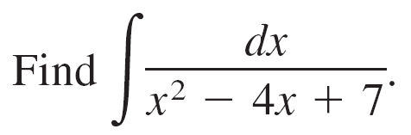
Example 4 – Completing the Square
Solution:
You can write the denominator as the sum of two squares, as follows.
x² – 4x + 7 = (x² – 4x + 4) – 4 + 7
= (x – 2)² + 3
= u² + a²

Slide 11
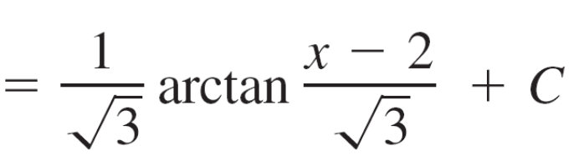
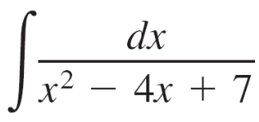
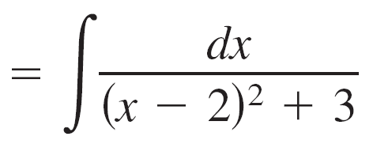
Example 4 – Solution
cont’d
Now, in this completed square form, let u = x – 2 and a = .

Slide 12
Review of Basic Integration Rules

Slide 13
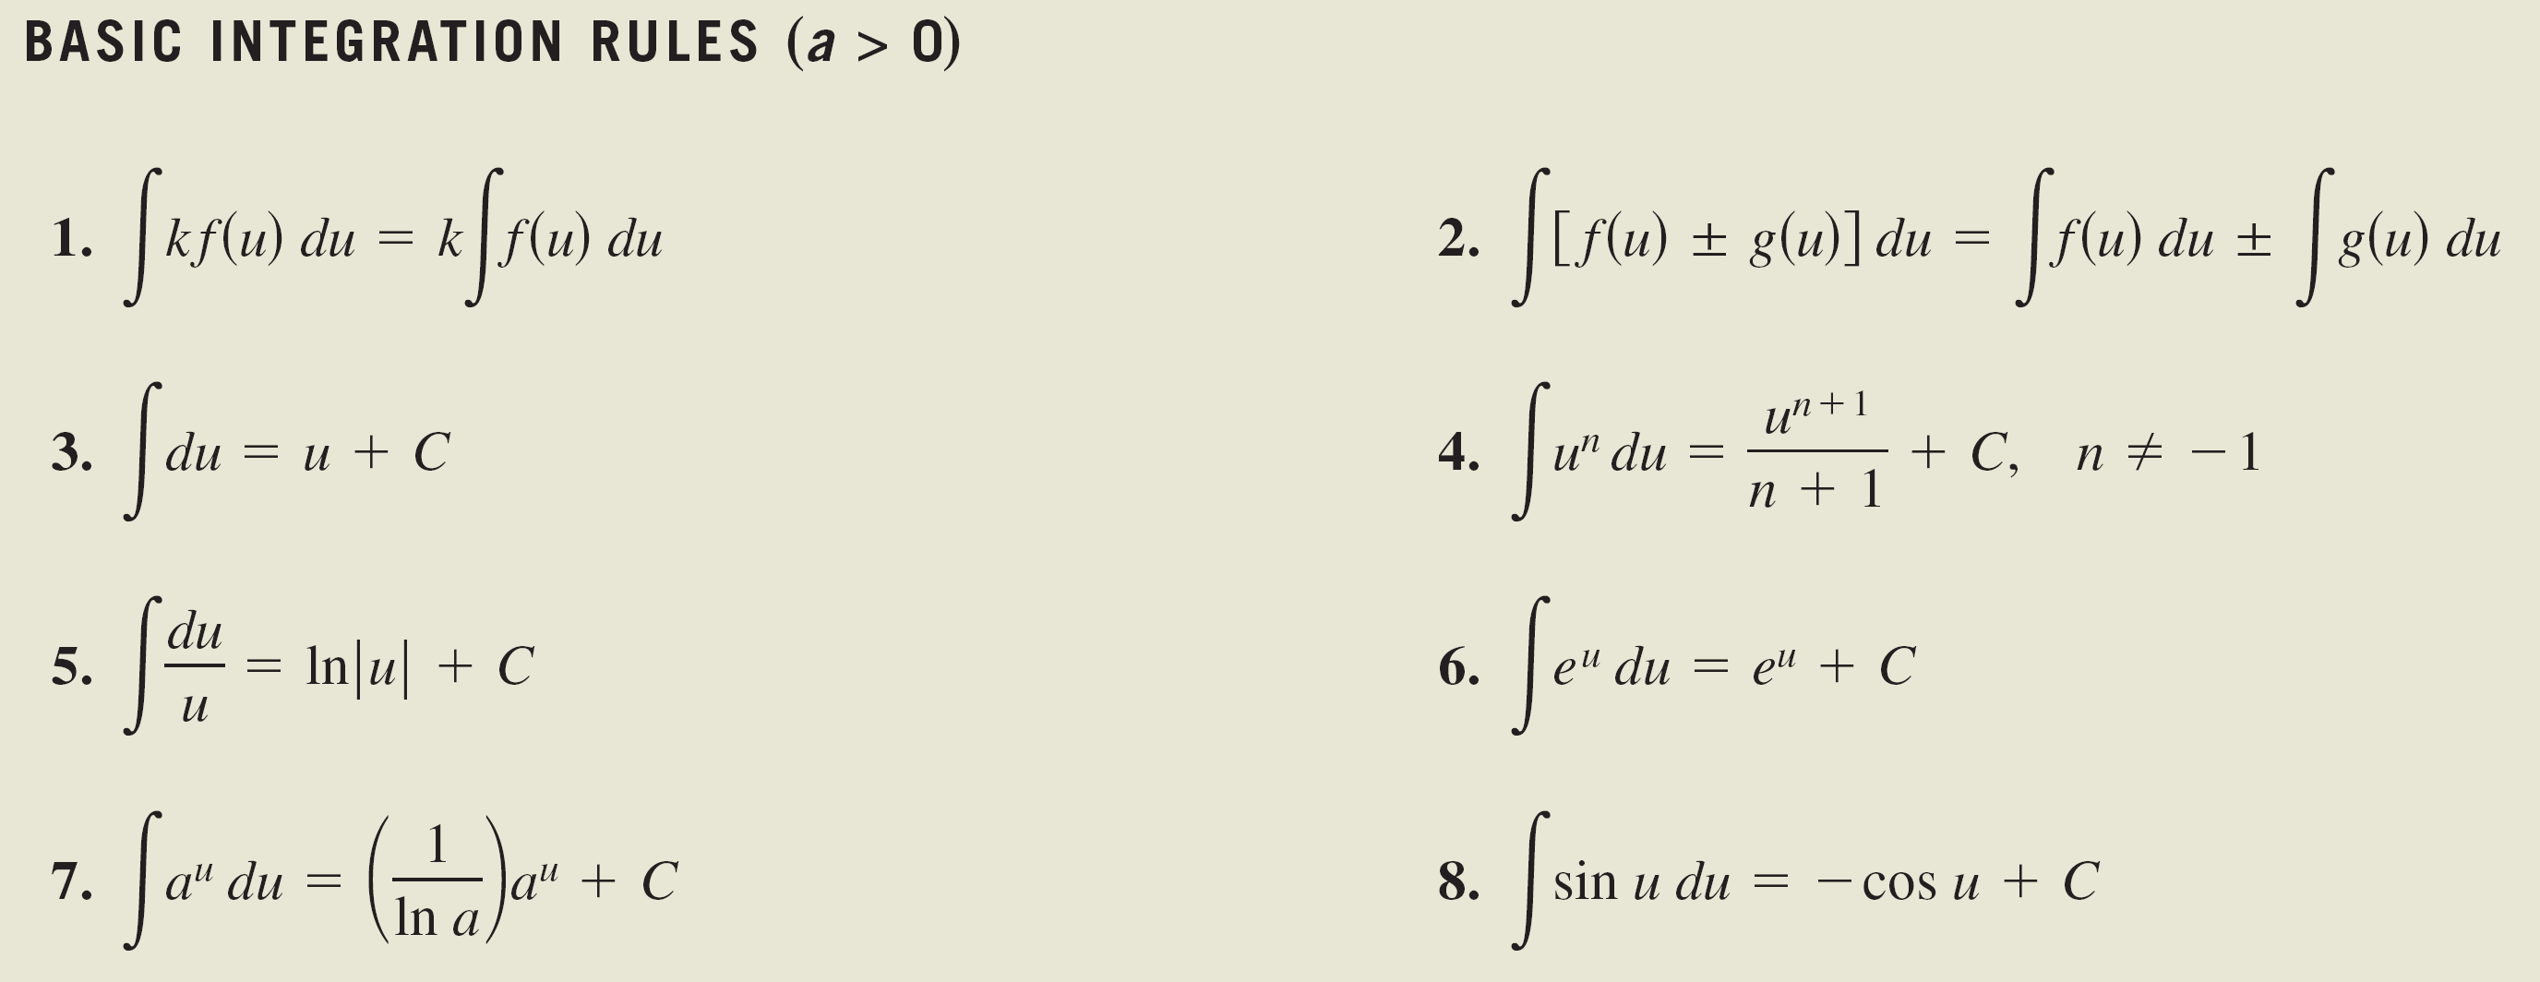
Review of Basic Integration Rules
You have now completed the introduction of the basic integration rules. To be efficient at applying these rules, you should have practiced enough so that each rule is committed to memory.

Slide 14
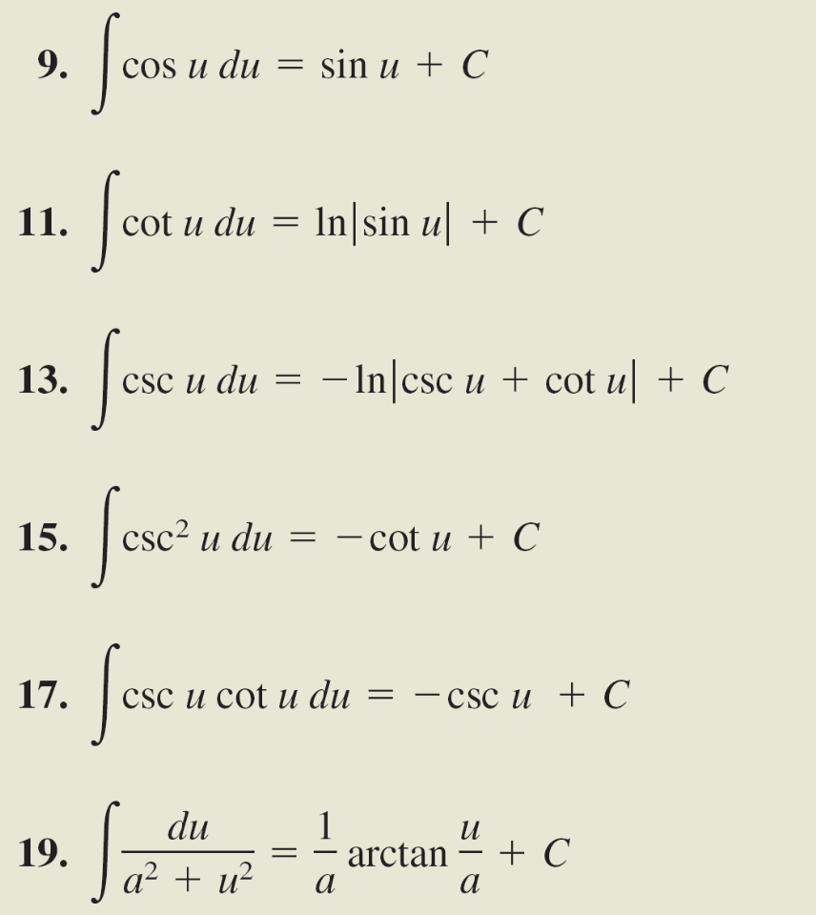
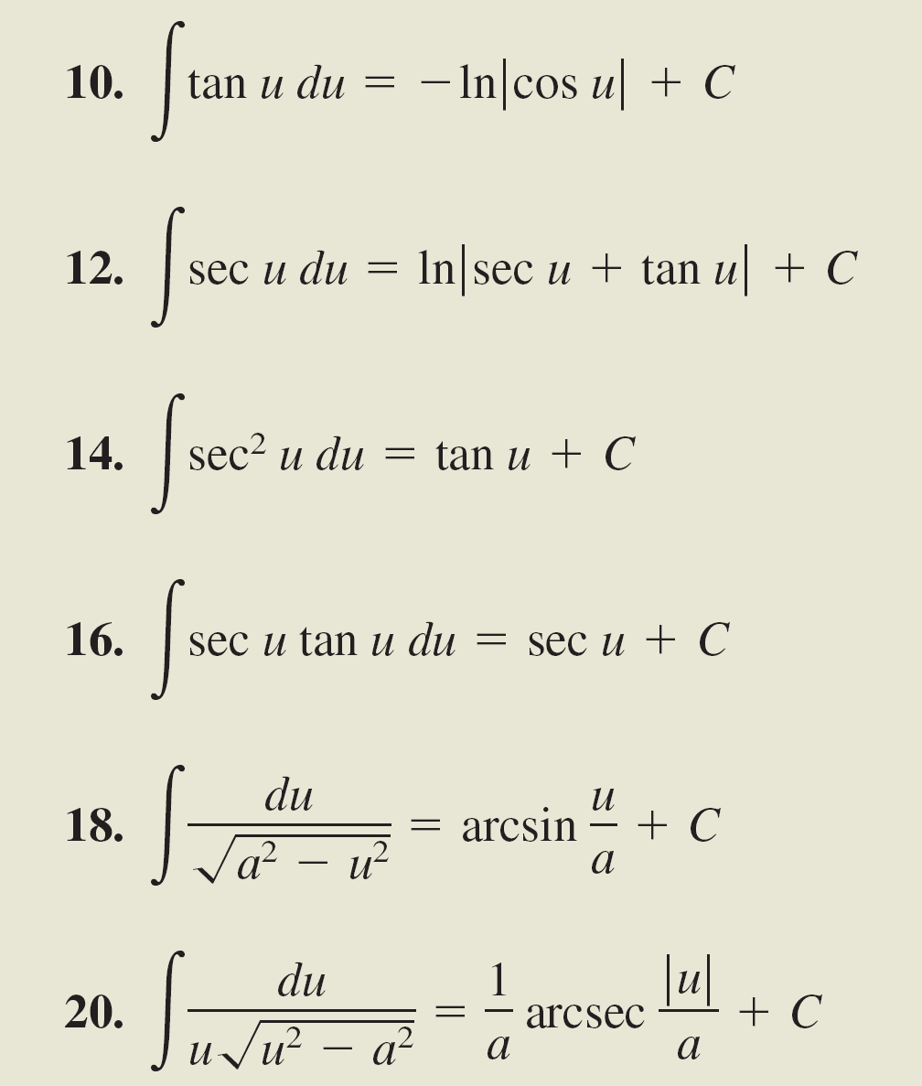
Review of Basic Integration Rules
cont’d

Slide 15
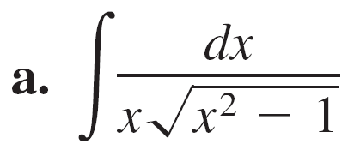
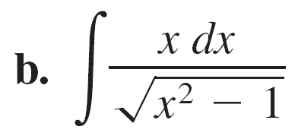
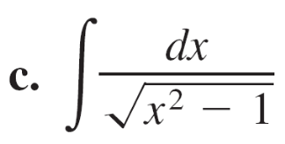
Example 6 – Comparing Integration Problems
Find as many of the following integrals as you can using the formulas and techniques you have studied so far in the text.

Slide 16
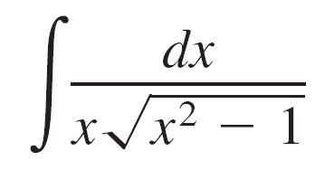
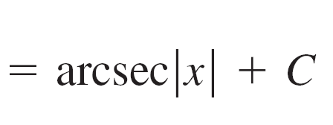
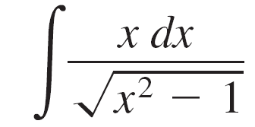
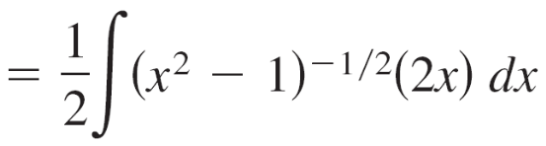
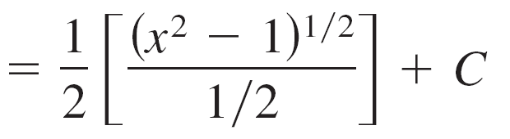

Example 6 – Solution
a. You can find this integral (it fits the Arcsecant Rule).
b. You can find this integral (it fits the Power Rule).
c. You cannot find this integral using the techniques you have studied so far.

